Slide 1
Agile in software process

Slide 2
Agile In software Development
Agile method is a mix of Iterative and Incremental approach, along with focus on customer involvement and interaction, etc. supports early delivery of value to the customer
Agile methodology was developed to respond to changes quickly and smoothly
Agile methodology is a collection of values, principles, and practices that incorporates iterative development, test, and feedback into a new style of development.

Slide 3
Agile Process
Development is incremental rather than sequential. Software is developed in incremental, rapid cycles
People and interactions are emphasized, rather than processes and tools. Customers, developers, and testers constantly interact with each other
Working software is the priority rather than detailed documentation. Agile methodologies rely on face-to-face communication and collaboration
Customer collaboration is used, rather than contract negotiation. All agile projects include customers as a part of the team
Responding to change is emphasized, rather than extensive planning.

Slide 4
Approaches to Agile methodologies
Agile methodology has various derivate approaches,
such as Extreme Programming,
Dynamic Systems Development Method (DSDM), and SCRUM.
Extreme Programming is one of the most widely used approaches.
Extreme programming is a software development methodology which is intended to improve software quality and responsiveness to changing customer requirements.
Scrum is a framework that helps teams work together. ... Often thought of as an agile project management framework,
Scrum describes a set of meetings, tools, and roles that work in concert to help teams structure and manage their work.

Slide 5
Scrum workflow
Product backlog → Sprint planning → sprint backlog -- > sprint (schedule with one to three week) → potentially shippable product with Sprint review → sprint retrospection
Product owner responsible for the product features
Scrum master responsible to protect the team and the process
Team – Development/Testing/review
Product backlog – who creates requirement
User needs As Is what and so that
Sprint backlog
Burn down chart – show zero points once the work is complete

Slide 6
Scrum workflow
Sprint planning – Product owner/Scrum master
Daily scrum – Review with pre/current/post
Sprint review – documentation to the work complete to the product owner
Scrum – Agile

Slide 7
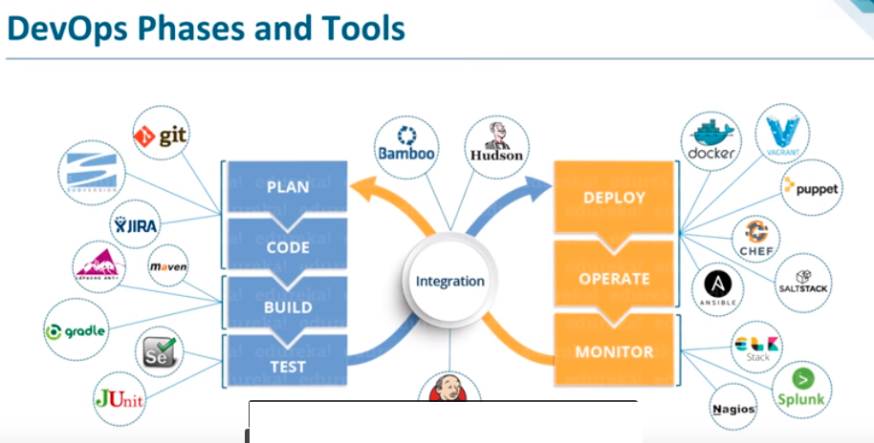
DevOps Pipeline for CI and CD

Slide 8
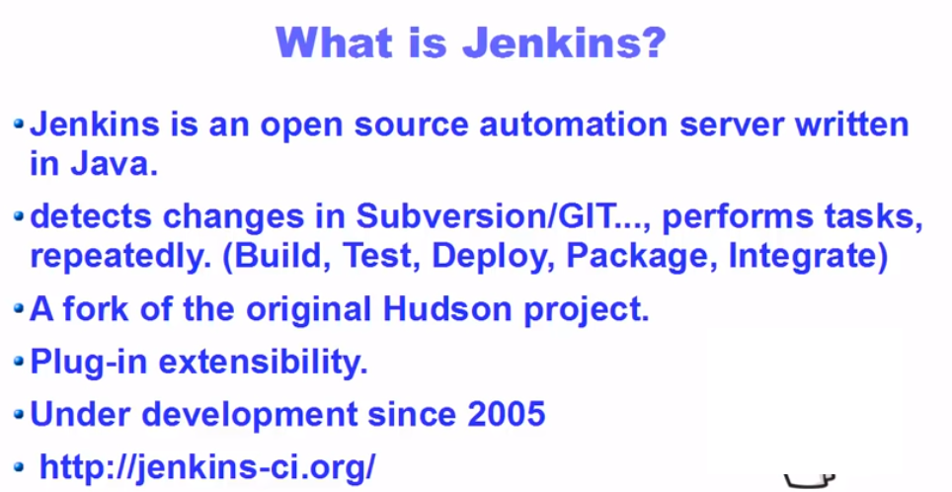
What is Jenkis

Slide 9
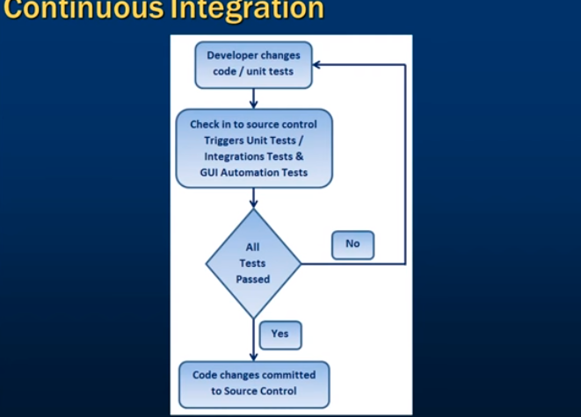
Continuous Integration

